Slide 1

LESSON 3 – Marketing
For my sweetheart

Slide 2

Summary
lean on, cabinet, filing cabinet, close, close to, serve, fill out, vase

Slide 3

attract
Attract other people

Slide 4
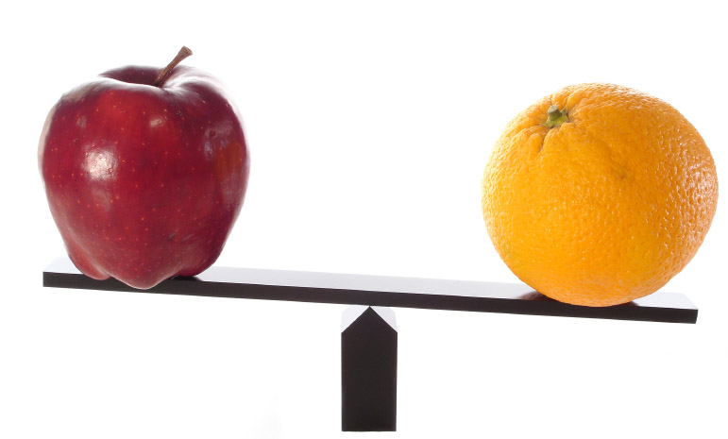
compare
Compare the two products

Slide 5
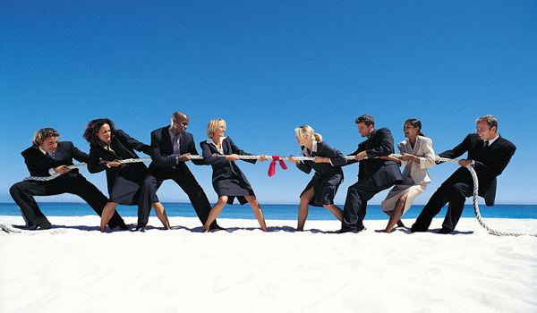
competition
Masterchef is the competition cooking

Slide 6
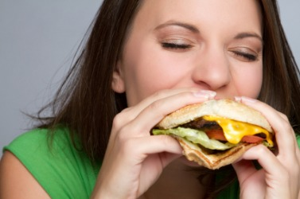
consume
Consume power

Slide 7

convince
persuasion
He convinced me that he was right

Slide 8
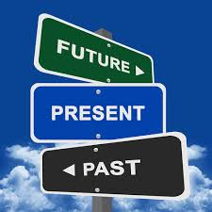
currently
Currently, I love you.

Slide 9
Adj vs Adv
Danh từ => dùng tính từ Động từ => dùng trạng từ

Slide 10
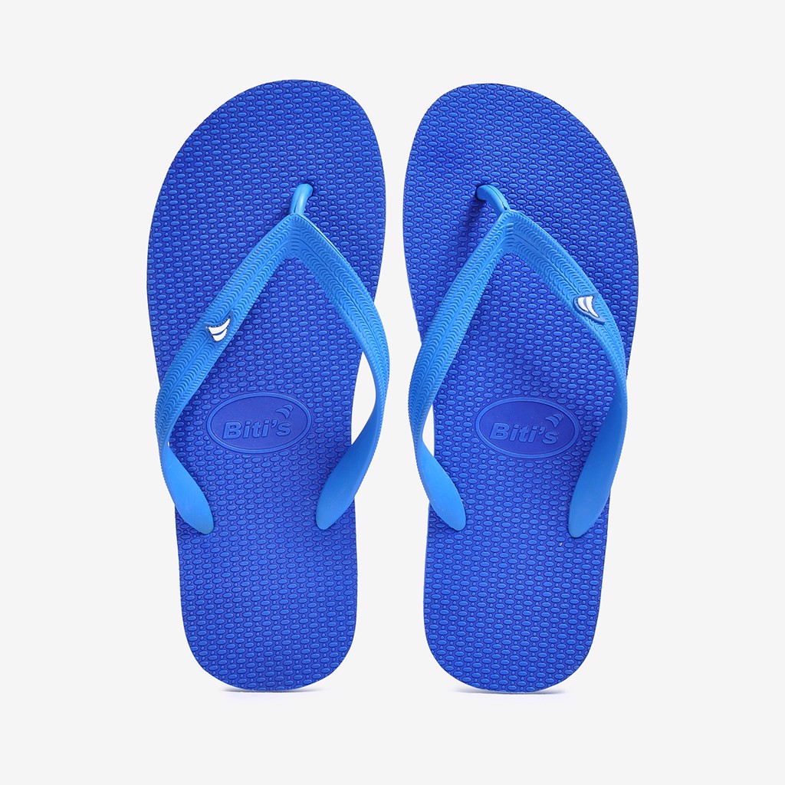
fad
“Dep Lao” is a fad sandal.

Slide 11

inspiration
He is an inspiration for other people.

Slide 12

market
stock market

Slide 13

product
productive
Her marketing is productive

Slide 14

satisfaction
Satisfaction level

Slide 15

That’s all

Slide 16
Thanks!
Any questions?
You can find me anytime

